Slide 1
Object Tracking in
Wireless Sensor Networks
Cheng-Ta Lee

Slide 2
Outline
Introduction to OTSNs
  Object Tracking Sensor Networks
  Impacting Factors
Object Tracking Methods
  Prediction-base
    Cluster and Prediction-base
  Tree-base
Conclusions and Future Works

Slide 3
Object Tracking Sensor Networks (OTSNs) (1/3)‏
“In many applications, a wireless network needs to detect and track mobile targets, and disseminate the sensing data to mobile sinks”
  Military
    Tracking enemy vehicles
    Detecting illegal border crossings
  Civilian
    Tracking the movement of wild animals in wildlife preserves
The information of interests
  Location, speed, direction, size, and shape

Slide 4
Object Tracking Sensor Networks (OTSNs) (2/3)‏
“In an OTSN, a number of sensor nodes are deployed over a monitored region with predefined geographical boundaries”
“The base station acts as the interface between the OTSN and applications by issuing commands and collecting the data of interests”
“A sensor node has the responsibility for tracking the object intruding its detection area, and reporting the states of the mobile objects with certain reporting frequency, which is adjustable to the network and application requirements”

Slide 5
Object Tracking Sensor Networks (OTSNs) (3/3)‏
Object tracking sensor networks have two critical operations
  Monitoring
    sensor nodes are required to detect and track the movement states of mobile objects
  Reporting
    the nodes that sense the objects need to report their discoveries to the applications
  These two operations are interleaved during the entire object tracking process

Slide 6
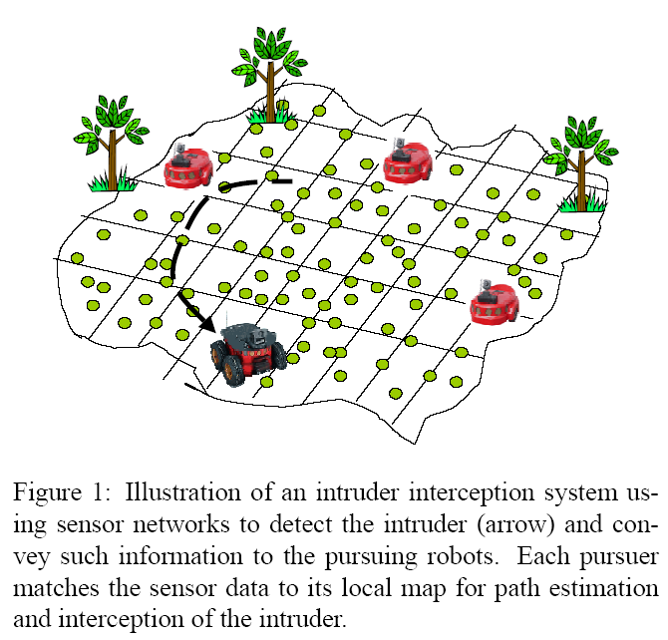
General Problem Statement
Scenario
  Arise at random in space and time
  Move with continuous motions
  Persist for a random length of time and disappear
Goal
  For each target, find its track

Slide 7
Impacting Factors
Number of moving objects
  “More moving objects inside the monitored region increase the total number of samplings and reporting”
Reporting frequency
  “Keeping the reporting frequency low can reduce the number of transmissions, and thus increases the lifetime of the OTSNs”
  Regular report vs. event-driven
Data precision
  “A higher data precision requires more data collection, more intricate computation and larger update packets, which result in more energy consumption on sensing, computing and communication”
Sensor sampling frequency
  “High sampling frequency incurs more energy consumptions”
Object moving speed
  “An OTSN needs to sample more frequently on an object which moves in high speed”.
Location models
  Based on the location identification techniques employed in the system, location model can be categorized as geometric (e,g., Coordinate) model and symbolic (e.g., Sensor ID) model

Slide 8
Research issues
Data aggregation
Routing
Signal processing
Energy conservation (the most critical)‏
20
15
Power (mW)‏
Radio
10
5
0
Sensing
CPU
TX
RX
IDLE
SLEEP
Power consumption of a typical senor node

Slide 9
Object Tracking Methods
Prediction-base [1-3]
  Cluster and Prediction-base
Tree-base

Slide 10
Prediction-base
It can minimize the number of nodes participating in the tracking.
Trades computation for communication
  Cost (computation) << Cost (communication)‏
“Different prediction models, wake up mechanisms and recovery mechanisms will affect the system performance”
Works well if one can tolerate
  “small amount of errors” in predictions
  “some latency” in generating prediction models
Basic idea
  A sensor need not transmit an expected reading

Slide 11
Object Tracking Methods
Prediction-base
  Cluster and Prediction-base [1]
Tree-base

Slide 12
Cluster and Prediction-base
Cluster-base
  Using multiple nodes instead of single one to get more precision
  Reduce the duplicated messages
    Information aggregation
    Achieve power saving
Prediction-base
  “Cluster-based methods often combine with prediction-base methods”
  “With prediction, it can minimize the number of nodes participating in the tracking activities”
Steps
  Tracking
  Prediction
  Update

Slide 13
On Localized Prediction for Power Efficient Object Tracking in Sensor Networks [1] (Monitoring)‏
Problem: Energy efficiency of the sensor networks can be improved by
  Reducing long distance transmissions
  Inactivating radio components as much as possible
Approach:
  Hierarchical clustering architecture
  Only wakes up needed sensor nodes to ensure seamless tracking of the object
  Dual prediction-based
    The sensor nodes do not send an update of object movement to its cluster head unless it is different from the prediction
  No prediction values need to be sent from cluster heads to sensor nodes
Result: Predictions are performed at both of sensor nodes and their cluster heads to reduce message transmissions. As a result, a significant amount of power can be saved

Slide 14
Prediction models
Heuristics INSTANT
  “Assumes object will stay in the current speed and direction”
Heuristics AVERAGE
  “Using the average of the object’s moving history to derives the future speed and direction”
Heuristics EXP_AVG
  “Assigns different weights to the different stages of history”
    Can reduce the transmission overhead

Slide 15
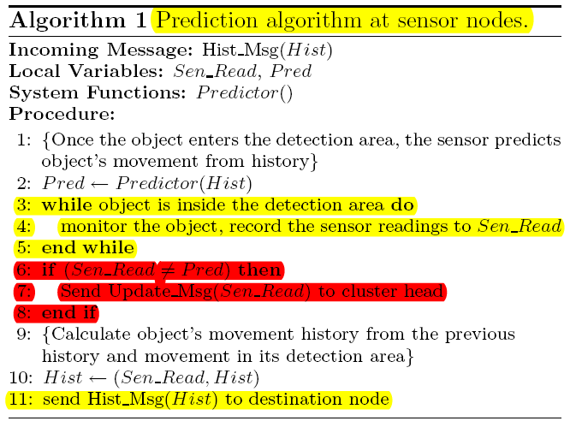
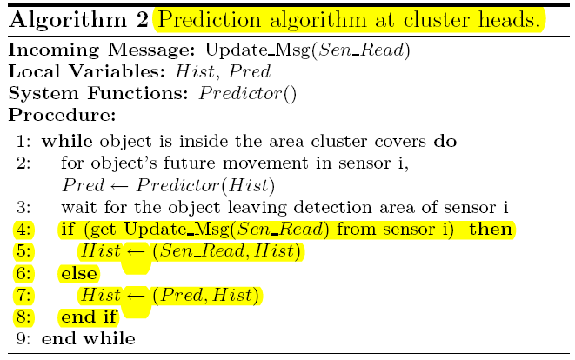
Algorithm
via a low power paging channel

Slide 16

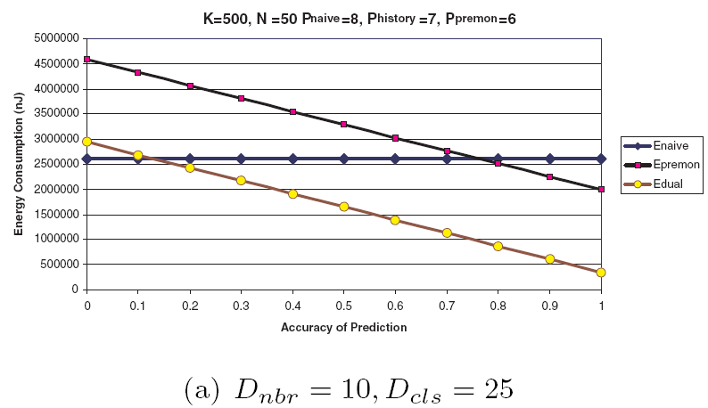
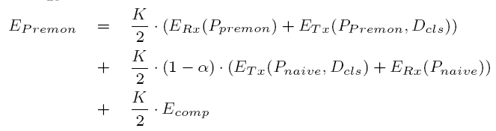
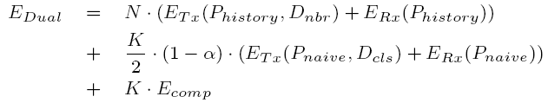
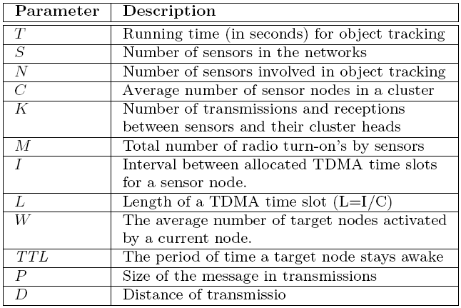
Evaluation of Prediction Effect

Slide 17
Prediction-based strategies for energy saving in object tracking sensor networks [2] (monitoring)‏
Problem: How to reduce the energy consumption (sensing and computing components; WINS sensor nodes) for object tracking under acceptable conditions?
Approach: Prediction-based energy saving scheme (PES) consists of
  prediction models
  wake up mechanisms
  recovery mechanisms
Result: “PES predicts the future movement of the tracked objects, which provides the knowledge for a wake up mechanism to decide which nodes need to be activated for object tracking. Different heuristics are discussed for both prediction and wakeup mechanisms”

Slide 18
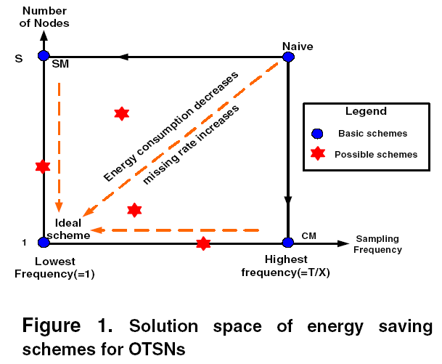
Basic schemes
Naive
  All nodes are in tracking mode all the time
  Worst energy efficiency
  Best possible quality of tracking
Scheduled Monitoring (SM)‏
  “All the S nodes will be activated for X second then go to sleep for (T − X) seconds”
Continuous Monitoring (CM)‏
  “Instead of having all the sensor nodes in the field wake up periodically to sense the whole area, only the sensor node who has the object in its detection area will be activated”
Ideal Scheme

Slide 19
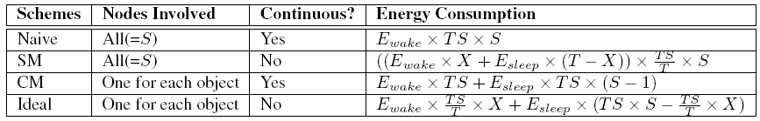
Table 1. Analytical evaluation for energy saving schemes

Slide 20
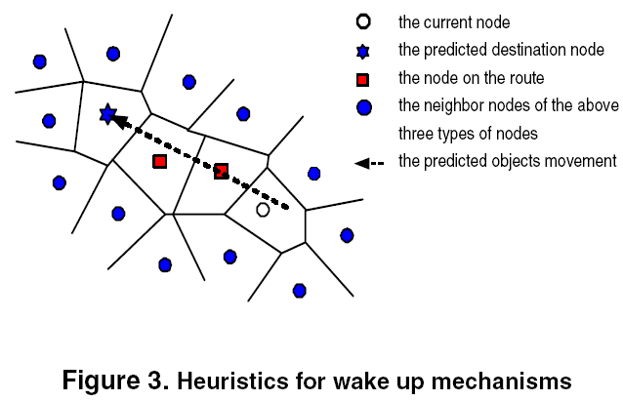
Wake up mechanisms
Heuristics DESTINATION
  “The current node only informs the destination node”
Heuristics ROUTE
  “Include the nodes on the route from the current node to the destination node”
Heuristics ALL_NBR
  “Current node also informs the neighboring nodes surrounding the route, current node and the destination”

Slide 21
Recovery mechanisms
ALL_NBR
  “recovery does not guarantee the activated nodes can find the missing object”
Flooding recovery
  “wakes up all the nodes in the network for object relocation, which ensures 0% missing rate”

Slide 22
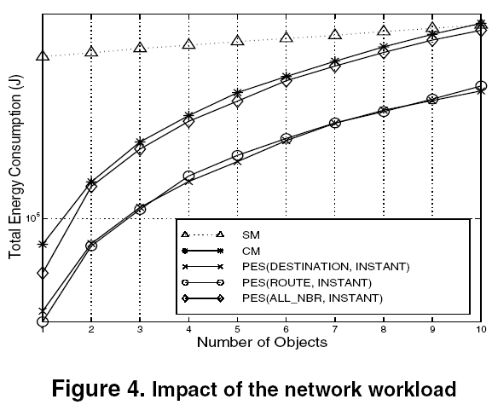
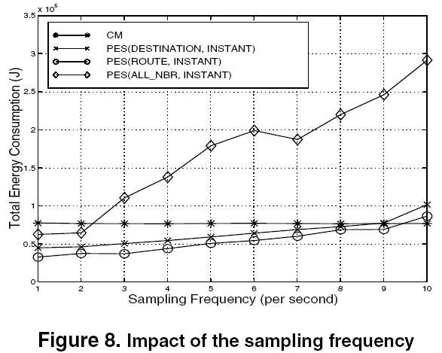
Performance Evaluation (1/2)‏

Slide 23
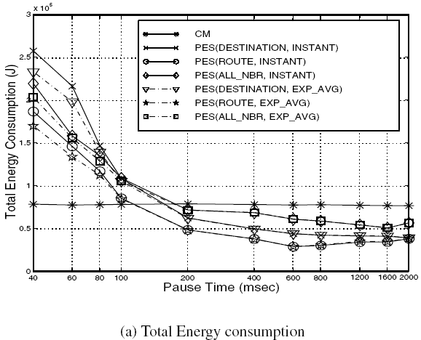
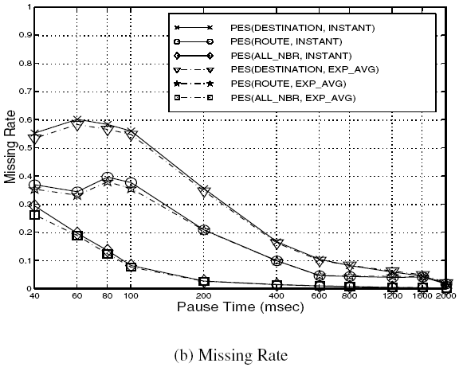
Performance Evaluation (2/2)‏

Slide 24
Dual prediction-based reporting for object tracking sensor networks [3] (Reporting)‏
Problem: How to investigate prediction-based approaches for performing energy efficient reporting in OTSNs?
Approach: Dual prediction-based reporting (DPR) reduces the energy consumption of radio components by minimizing the number of long distance transmissions between sensor nodes and the base station with a reasonable overhead. In DPR, both the base station and sensor nodes make identical predictions about the future movements of mobile objects based on their moving history.
Result: The Dual Prediction Reporting (DPR) mechanism, in which the sensor nodes make intelligent decisions about whether or not to send updates of objects movement states to the base station and thus save energy. DPR consists of two major components, i.e., location model and prediction model. The choice of a location model determines the granularity of the movement states of mobile objects. A prediction model, on the other hand, decides how to estimate the objects’ future movement from their movement history.

Slide 25
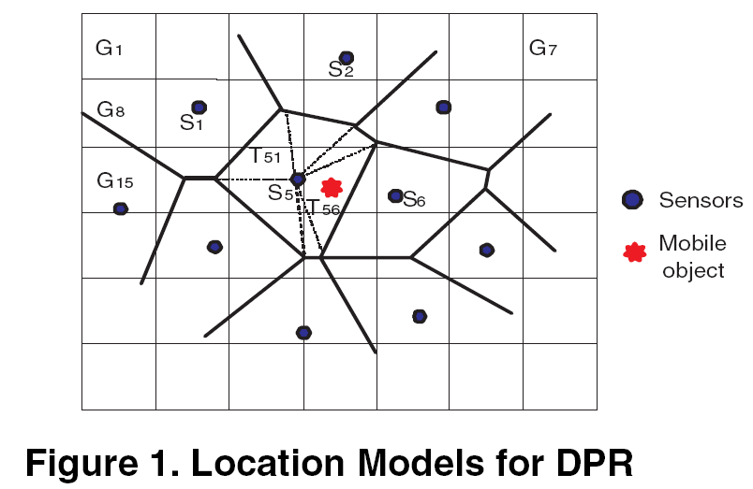
Location Models
Sensor cell
  Sensor ID (e.g., S₅)‏
Triangle
  “T₅₆ in Figure 1, the triangle in S5 and adjacent to S₆ represents the location of the mobile object”
Grid
  “G₁₈ indicates the ID of the grid where the object is detected”
Coordinate

Slide 26
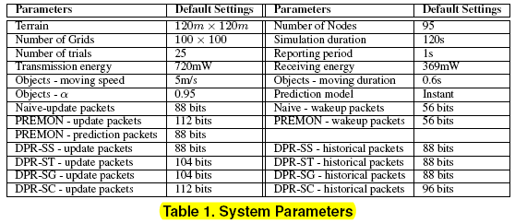
System Parameters

Slide 27
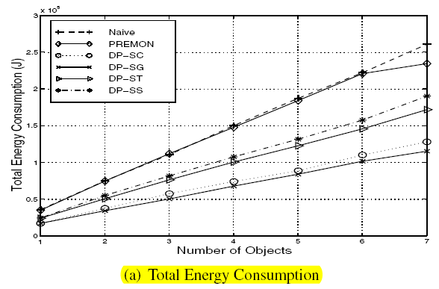
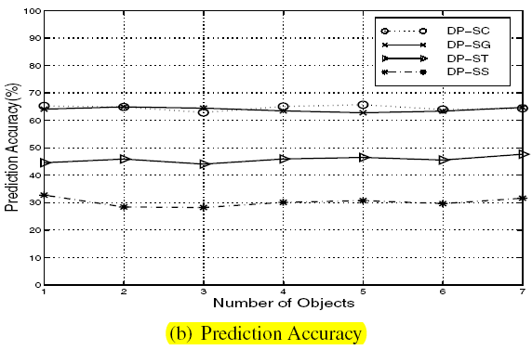
Performance Evaluation

Slide 28
Object Tracking Methods
Prediction-base
  Cluster and Prediction-base
Tree-base [4]

Slide 29
Efficient Location Tracking Using Sensor Networks [4]
Problem: “Real-world movement patterns are not likely to be uniform, because large-scale environments usually have inherent structure that makes this infeasible. For example, a downtown area of a city may consists of a street grid and buildings that prevent pedestrians from moving around arbitrarily.”
Approach:
  STUN (Scalable Tracking using Networked Sensors), a method for tracking large numbers of moving objects that gains efficiency through hierarchical organization
  DAB (drain-and-balance) method for building STUN hierarchies that take advantage of information about the mobility patterns of the objects being tracked
Result:
  Performance Metrics
    Communication Cost
    Delay

Slide 30
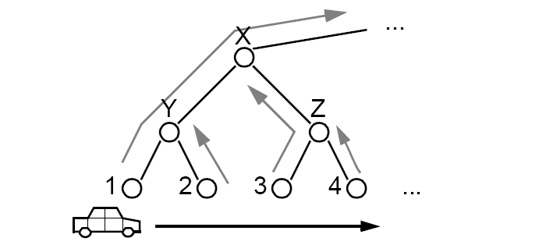
Basic Idea
communication nodes
sensors nodes

Slide 31
Scalable Tracking Using Networked Sensors (STUN)‏
“Track a set of moving objects by using a set of networked sensors as a distributed hierarchical data lookup structure”
“Adapt the overlay network topology to the observed movement patterns, in order to”
  Decrease communication cost
  Decrease detection latency

Slide 32

Example (1/2)‏
Object is registered in nodes along the path to the root (using detected set)‏
  When object moves, no updates needed in the unchanged portion of the path

Slide 33
Example (2/2)‏
Query is routed down the correct path to the leaf sensor (avoiding flooding)‏
Reply returns back to the root, carrying detailed information
2
3

Slide 34
Need to Adapt to Traffic Patterns
“The overlay topology for aggregating sensors information may not fit to traffic patterns”
Little traffic within low-level subtrees
Heavy traffic between top-level subtrees

Slide 35
Adaptation
“To build a lower cost tree, we take into account the object movement patterns”
Threshold subdivision method
  Use nodes below a threshold movement rate as top tree nodes
The frequent updates are handled near the bottom, resulting in reduced communication cost

Slide 36
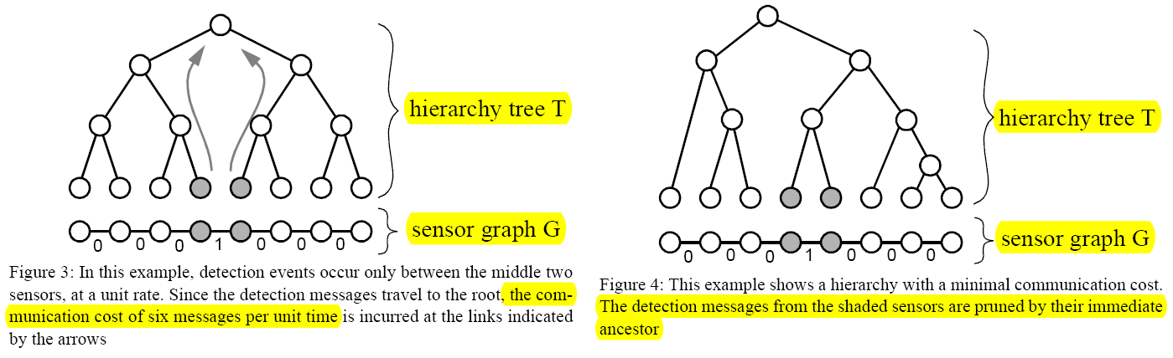
DAB: Drain-And-Balance method for constructing message-pruning tree

Slide 37
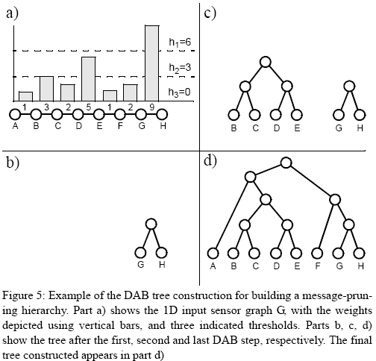
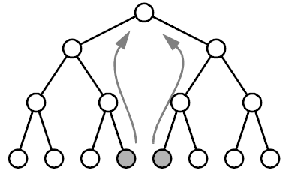


DAB Tree Construction
The expected value of the average weight
as the first threshold h₁
1+(1+3)+(3+2)+(2+5)+(5+1)+(1+2)+(2+9)+9=46
∴h₁ =46/8=5.75≒6
A B C D E F G H
B.T.: 2 12 4 30 2 8 18 =76
DAB: 4 6 8 10 6 6 18 =58
DAB Tree: 58
Balanced Tree: 76

Slide 38
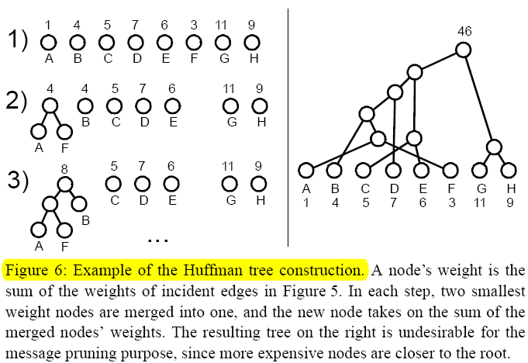
Comparison to Huffman Trees
“DAB tree construction assumes message pruning at intermediate tree nodes”
“DAB construction merges the most expensive nodes first”
“Huffman tree construction does not concern with tree balancing, unlike the DAB construction”
1+(1+3)+(3+2)+(2+5)+(5+1)+(1+2)+(2+9)+9=46

Slide 39
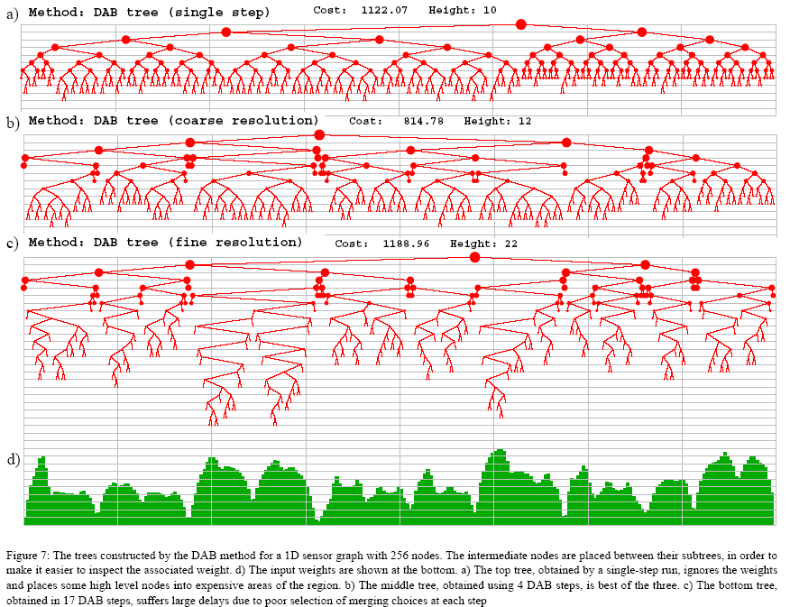
Performance (1/7)‏

Slide 40
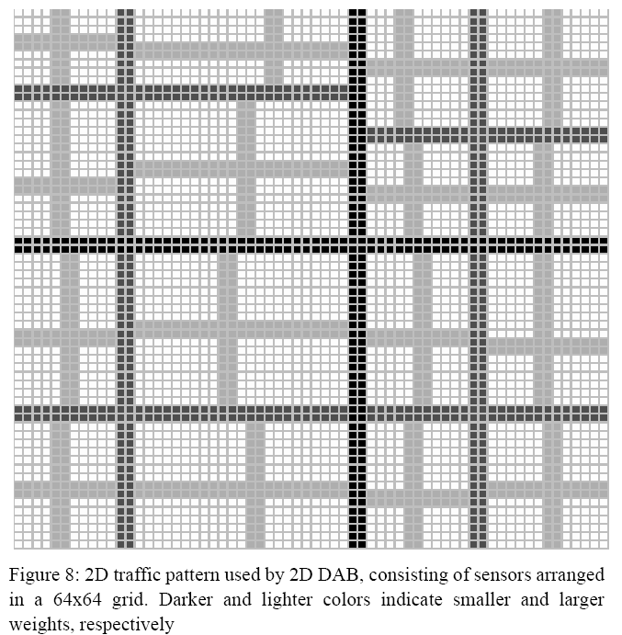
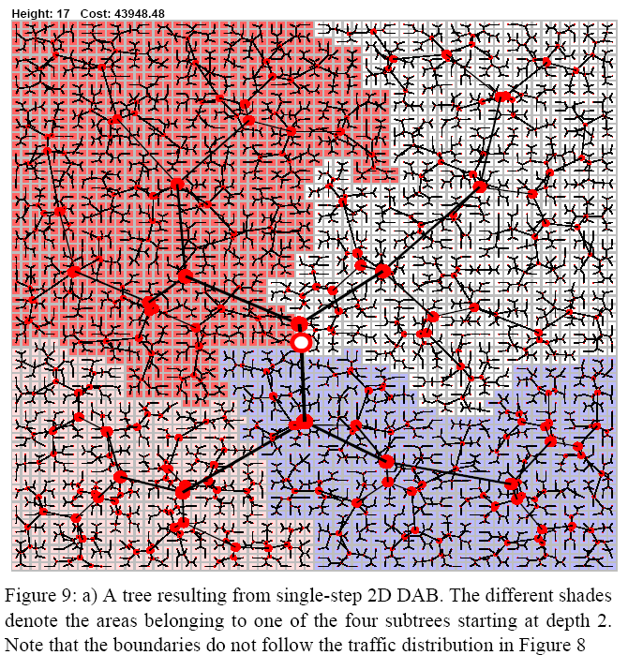
Performance (2/7)‏

Slide 41
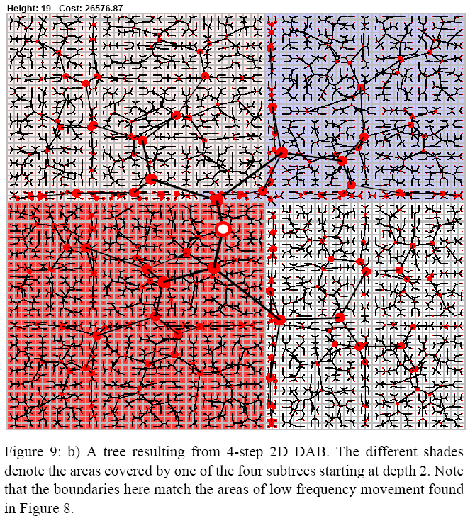
Performance (3/7)‏

Slide 42
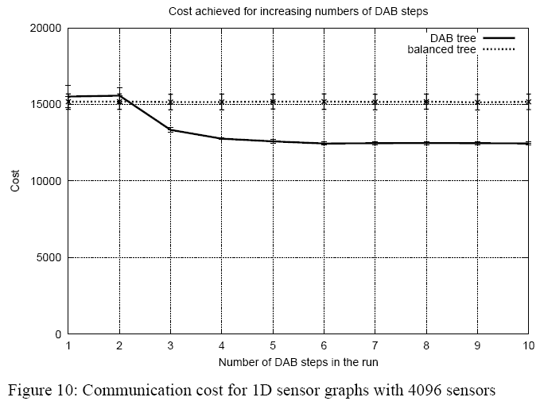
Performance (4/7)‏

Slide 43
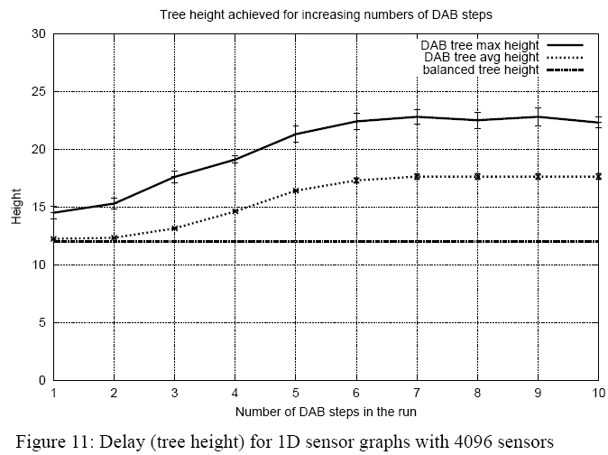
Performance (5/7)‏

Slide 44
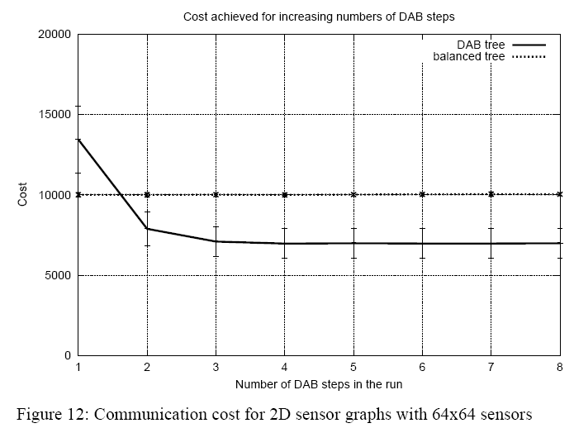
Performance (6/7)‏

Slide 45
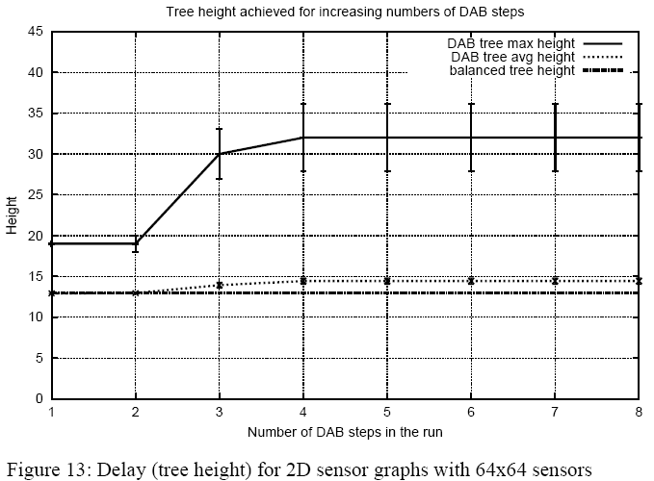
Performance (7/7)‏

Slide 46
Conclusions
Object Tracking Methods
  Prediction-base
    It can minimize the number of nodes participating in the tracking
  Cluster-base
    Using multiple nodes instead of single one to get more precision
    Reduce the duplicated messages
  Tree-base
    To efficiently help data collection and aggregation
Balancing object-tracking quality and network lifetime is a challenging task in sensor networks

Slide 47
Future Works
Tracking algorithm
  Compare current tracking algorithms
  Implement better algorithm
    Markov-model
      Power Control for Target Tracking in Sensor Networks (CISS, 2005)‏
    Optimization-base
      Communication cost
      Number of turn on sensors
      Time Spending for catching object
      Hybrid
  Object tracking with mobile sinks scenario in sensor networks
Wake up and recovery algorithm
  Optimize current algorithm
  Propose new and better algorithm

Slide 48
References
Yingqi Xu; Wang-Chien Lee, “On Localized Prediction for Power Efficient Object Tracking in Sensor Networks,” Proceedings of the 23 rd International Conference on Distributed Computing Systems Workshops (ICDCSW’03).
Yingqi Xu; Winter, J.; Wang-Chien Lee, “Prediction-based strategies for energy saving in object tracking sensor networks,” Mobile Data Management, 2004. Proceedings. 2004 IEEE International Conference on Mobile Data Management (MDM’04), 2004, pp. 346 – 357.
Yingqi Xu; Winter, J.; Wang-Chien Lee, “Dual prediction-based reporting for object tracking sensor networks,” The First Annual International Conference on Mobile and Ubiquitous Systems: Networking and Services (MobiQuitous’04), Aug. 22-26, 2004, pp. 154 – 163.
Kung, H.T.; Vlah, D, “Efficient location tracking using sensor networks,” Wireless Communications and Networking Conference (WCNC), 2003.

